Slide 1
Washington DC/Northern Virginia EMC Chapter
Officer names:
Mike Violette, Chair
Steve Koster, Vice-Chair/Treasurer
Mark Maynard, Secretary
Number of members: 25
Average Meeting Attendance: 10-12
Best Practices
Working with other local chapters with cross-over interests, for joint meetings
Activities/Highlight activities
Joint Meeting Series with MT&T Chapter:
FCC Engineer presentation on latest FCC updates and requirements
FFT Receiver presentation from Rhode & Schwarz
MIL-STD 461 presentation

Slide 2
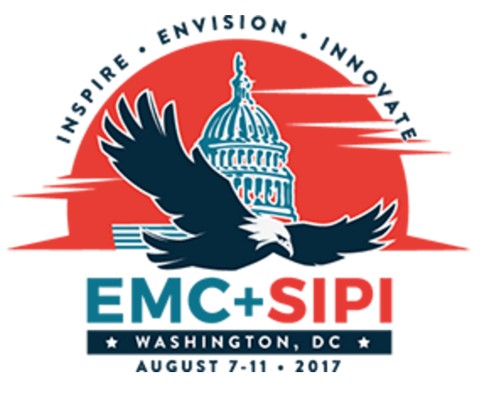
Washington DC/Northern Virginia EMC Chapter
Activities/Highlight activities (continued)
Host Chapter for the 2017 EMC/SIPI Symposium in Washington DC, August 7-11, 2017. Chair: Mike Violette, info@wll.com

